Slide 1
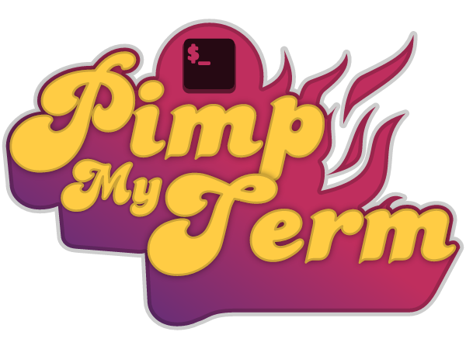

Slide 2
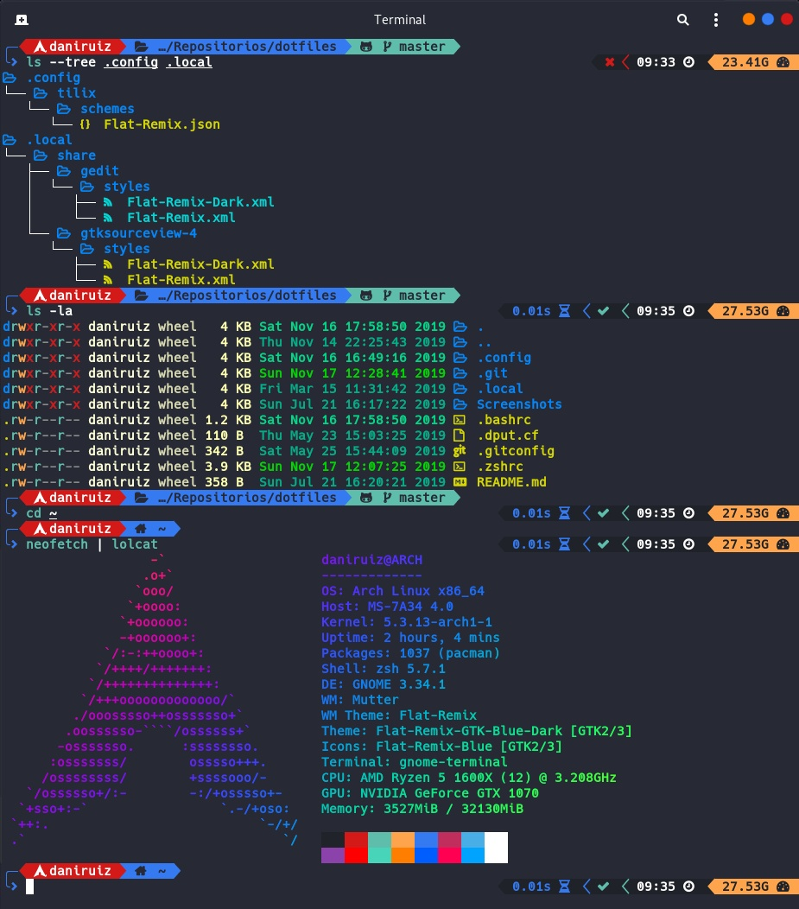
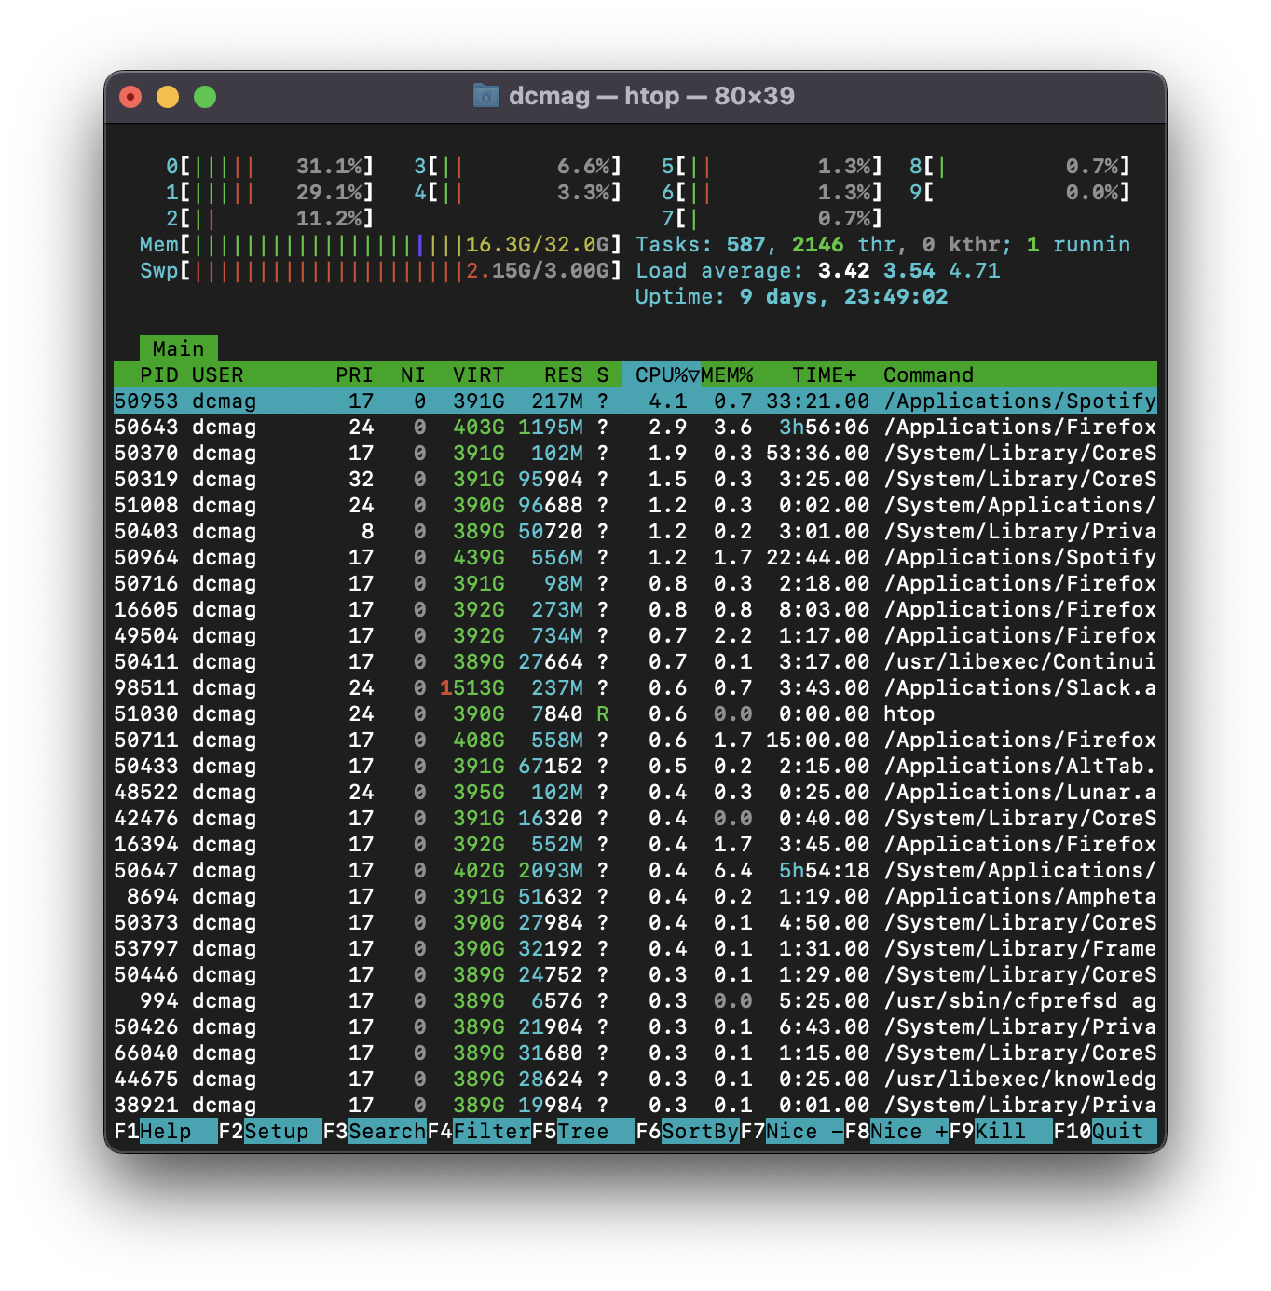
YO DAWG

Slide 3
TERMINAL BASICS

Slide 4
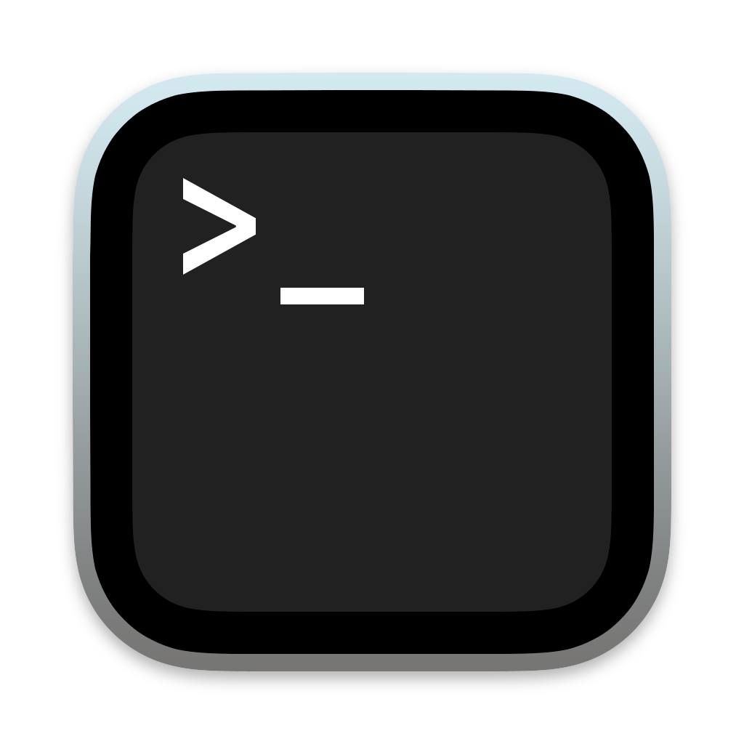

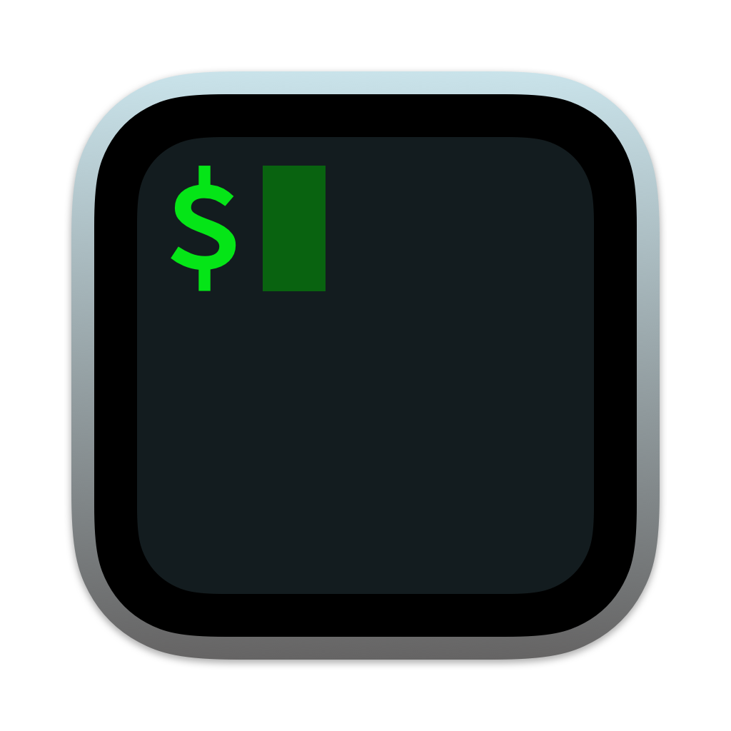

WHAT IS A TERMINAL EMULATOR?
A computer program that emulates a video terminal! (some examples below)
You can use any terminal emulator that you want! Each have something to offer!
Notes:
Open my own here, along with the mac terminal to show they are just different applications

Slide 5




WHAT IS A SHELL?
Your Command-Line Interpreter (CLI)!
Just a program that processes commands and outputs the results

Slide 6
FONTS & COLORS

Slide 7
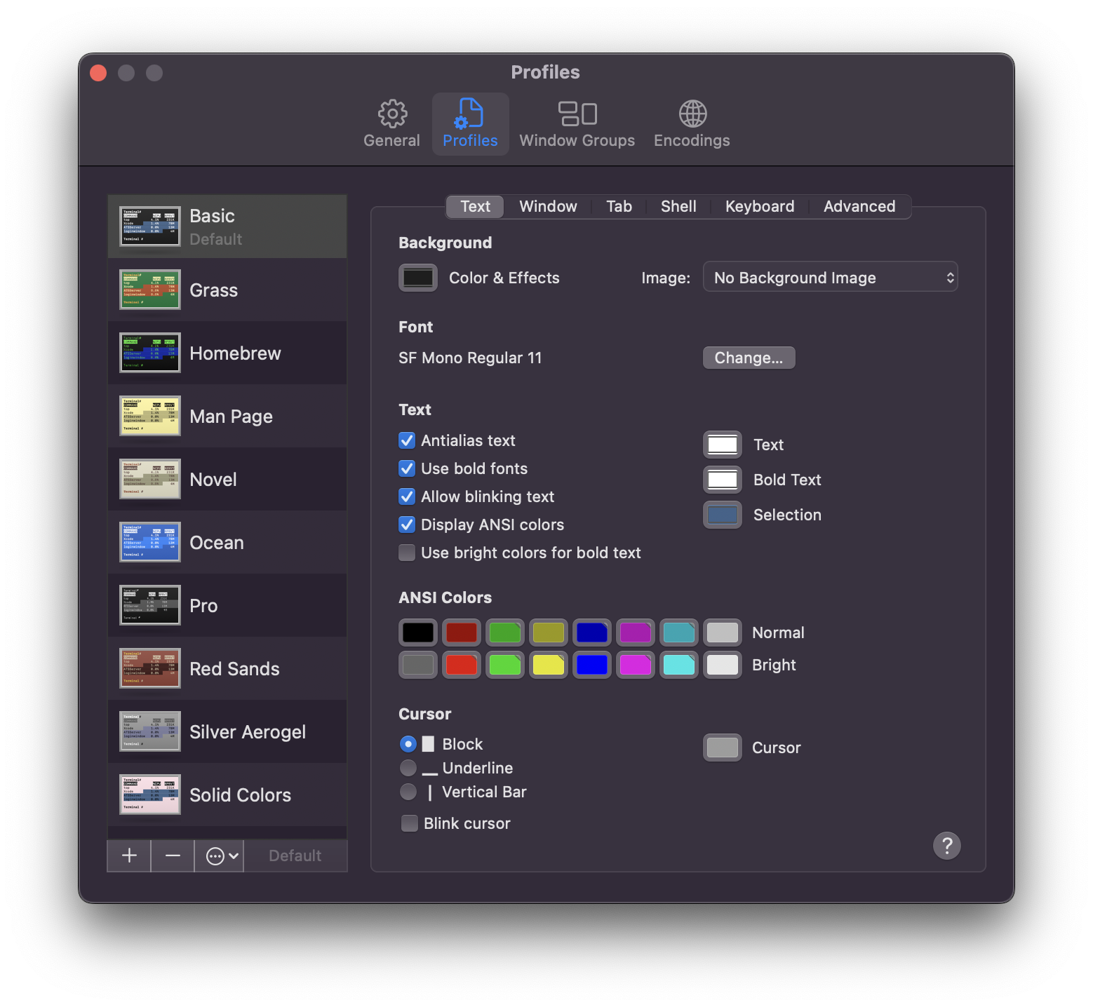
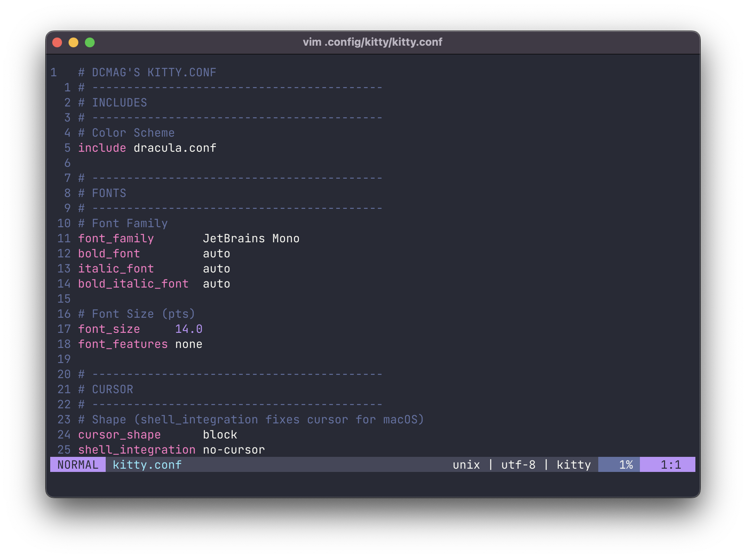
THERE’S A FONT FOR EVERYONE!
But how you apply it depends on your terminal emulator…

Slide 8

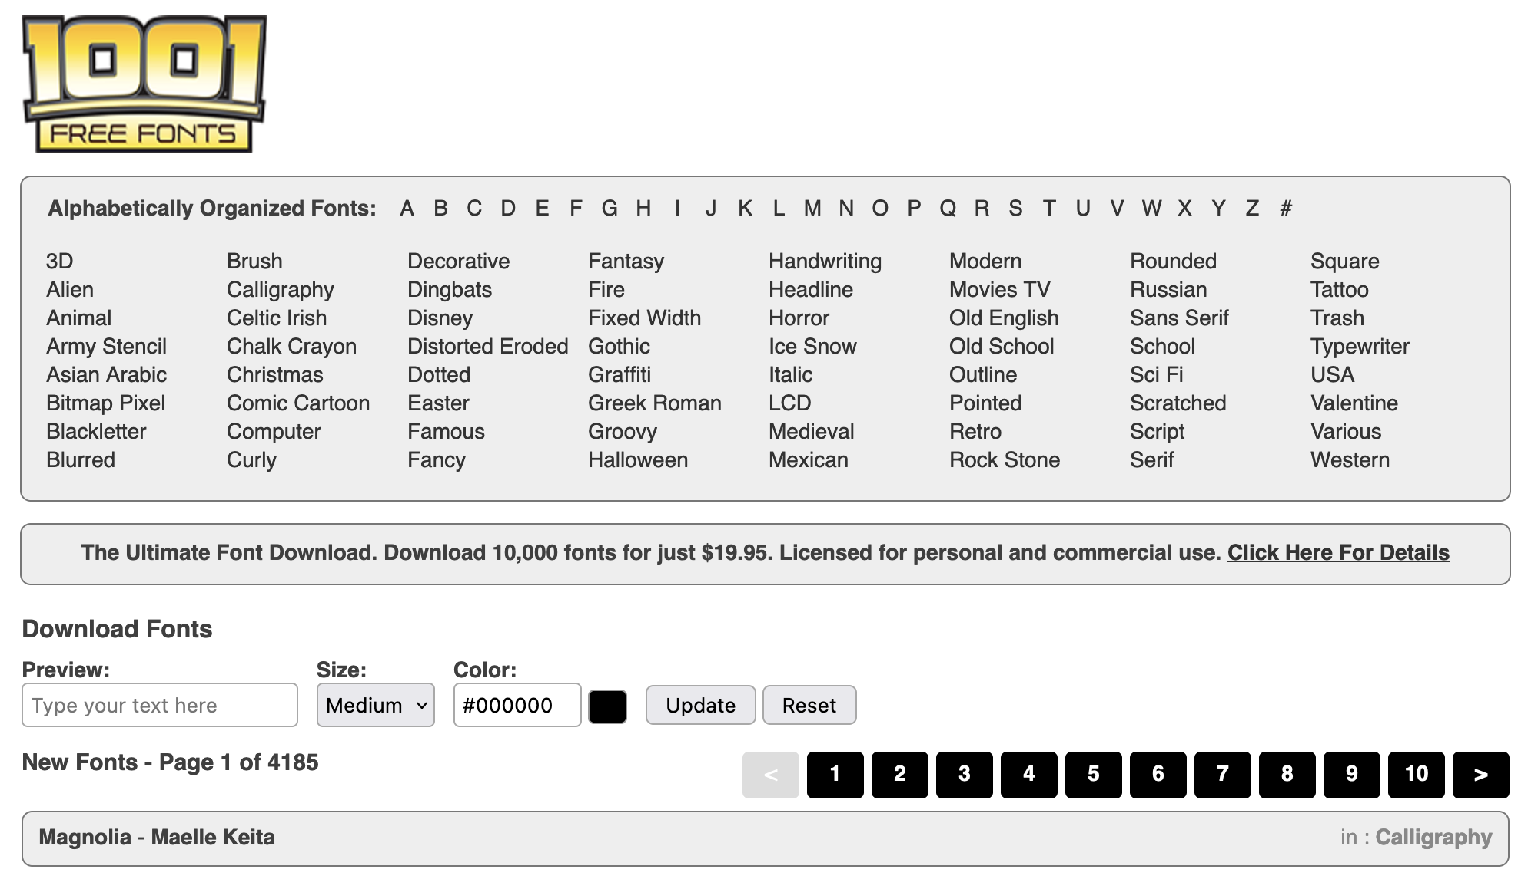
BUT WHERE DO I FIND THEM?
Google Fonts has a lot of cool (and best of all free) fonts! Or you can go to a sketchy website…

Slide 9
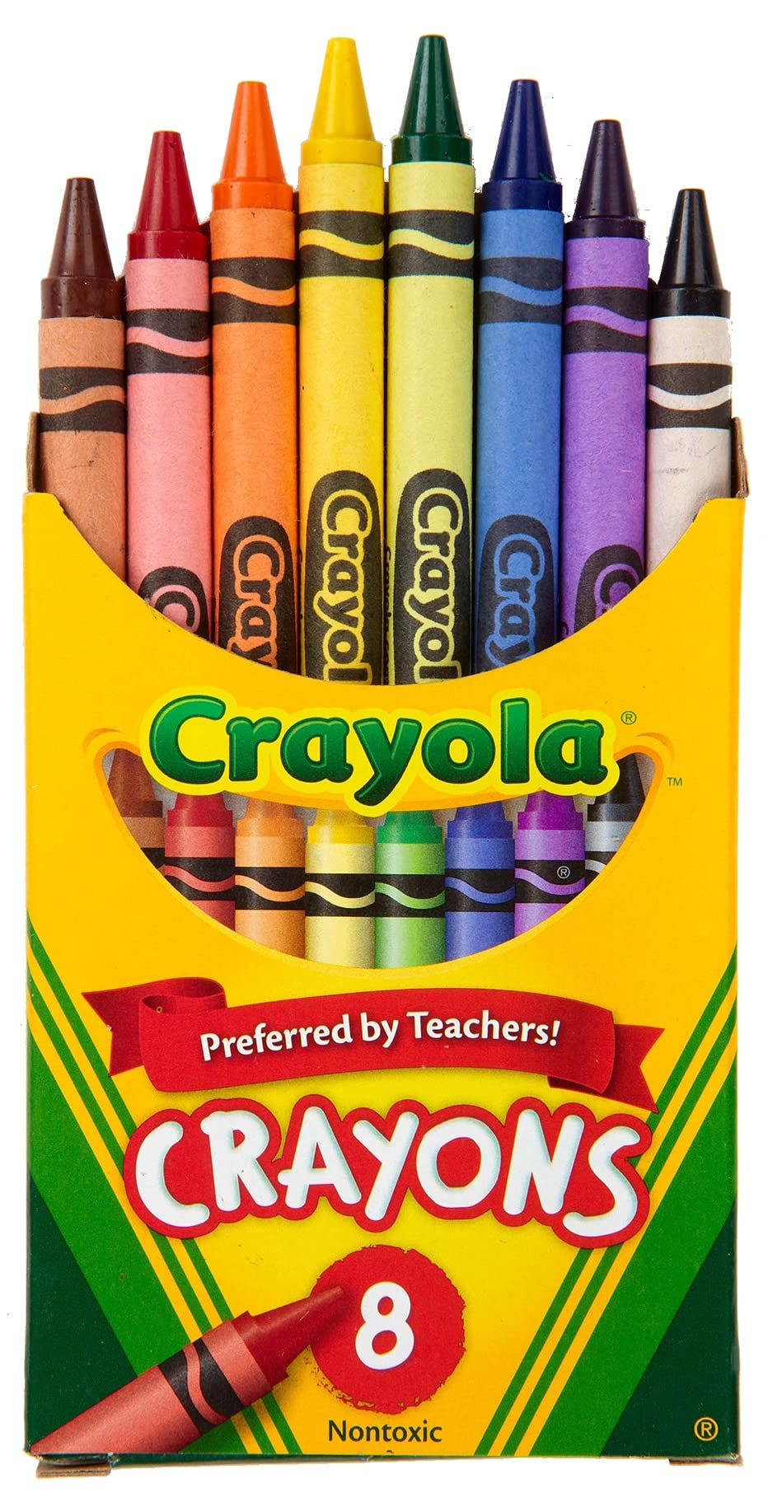
GET YOUR CRAYOLA OUT KIDDOS

Slide 10
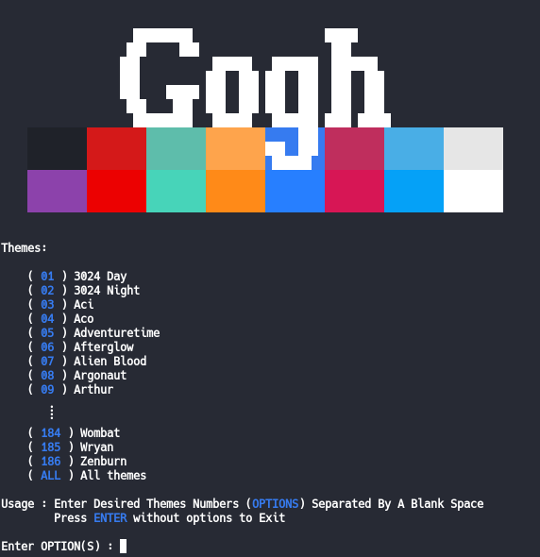
YOUR COLOR SCHEME
Terminals usually display a max of 8 colors. You can customize these colors on your own (how you do it depends on your terminal emulator of course) but it’s easier to just mooch off of someone else’s hard work! There are tools/websites like:
Gogh (https://gogh-co.github.io/Gogh/)
Terminal.sexy (https://terminal.sexy/)
To help you with the heavy lifting!

Slide 11
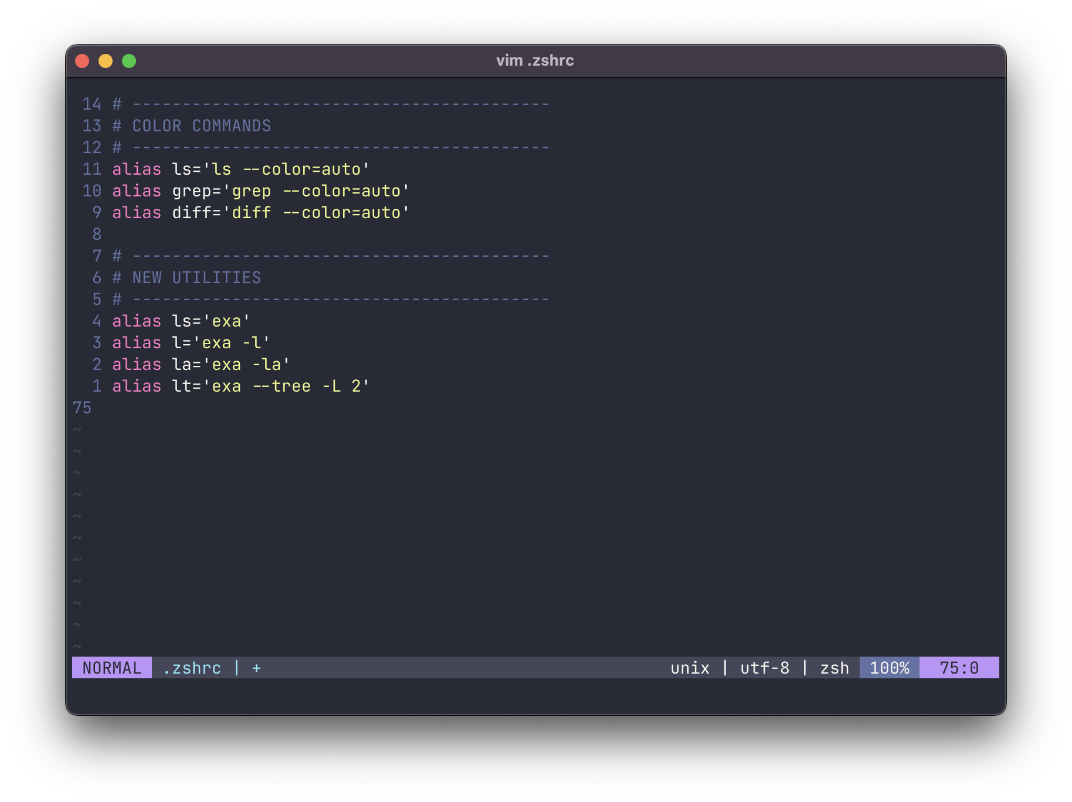
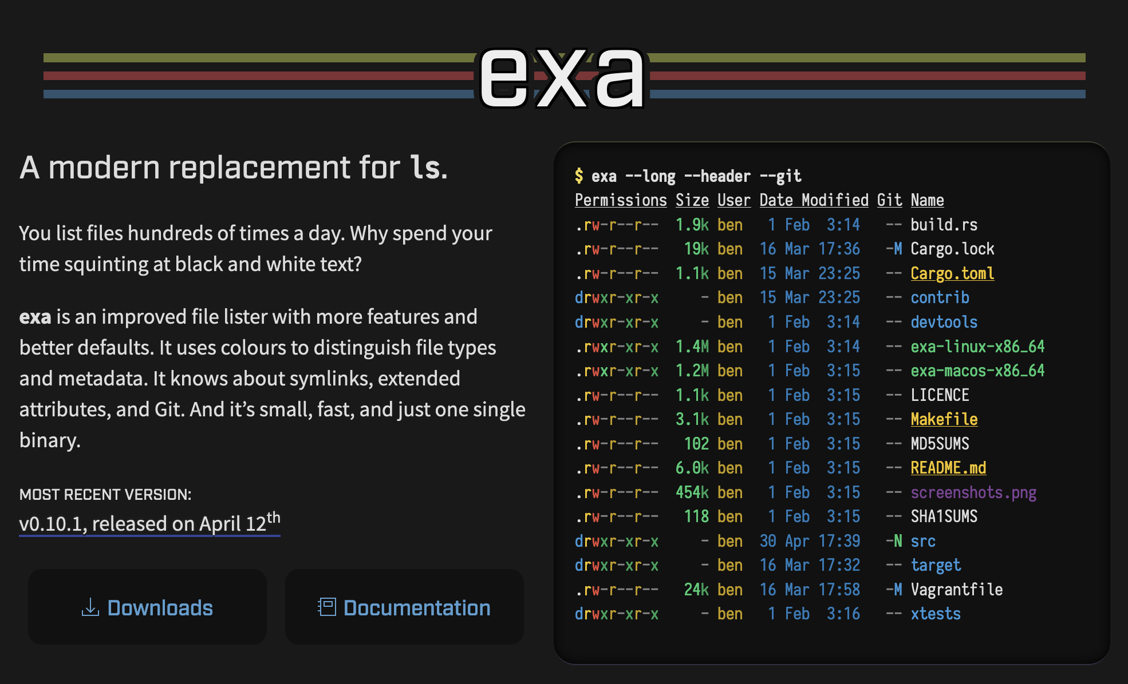
PUTTING THOSE COLORS TO USE
Some commands actually do support color highlighting!

Slide 12
100%
Of cools kids use neofetch (strictly for informative purposes of course)
|
https://github.com/dylanaraps/neofetch

Slide 13
ACTIVITY MONITORS
—----- - - - - -
IMPRESS ALL YOUR FRIENDS

Slide 14
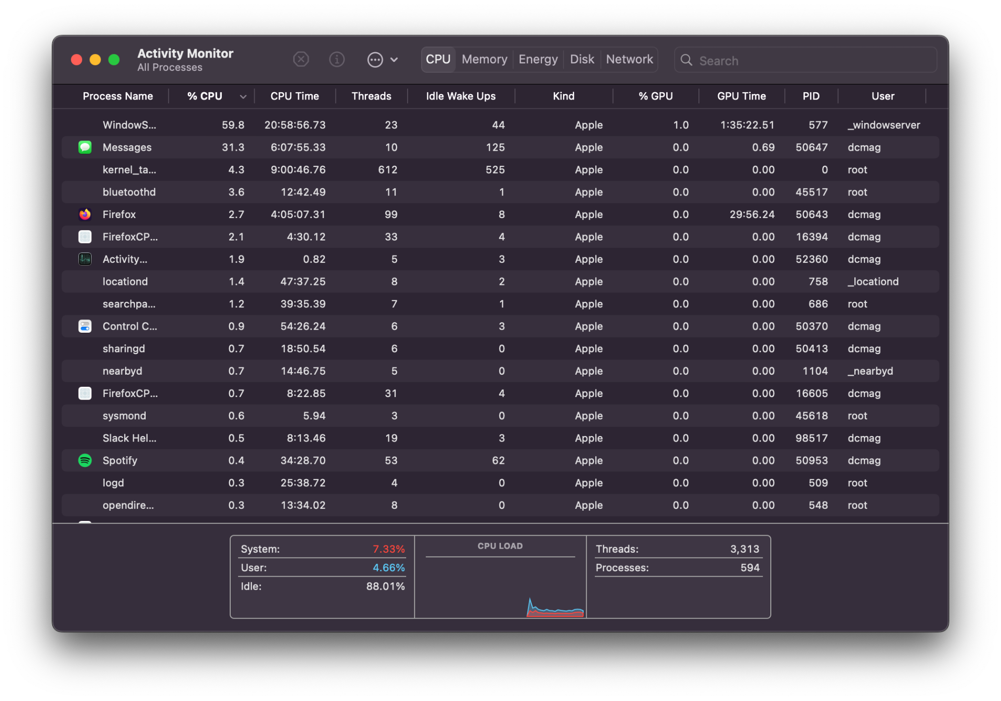
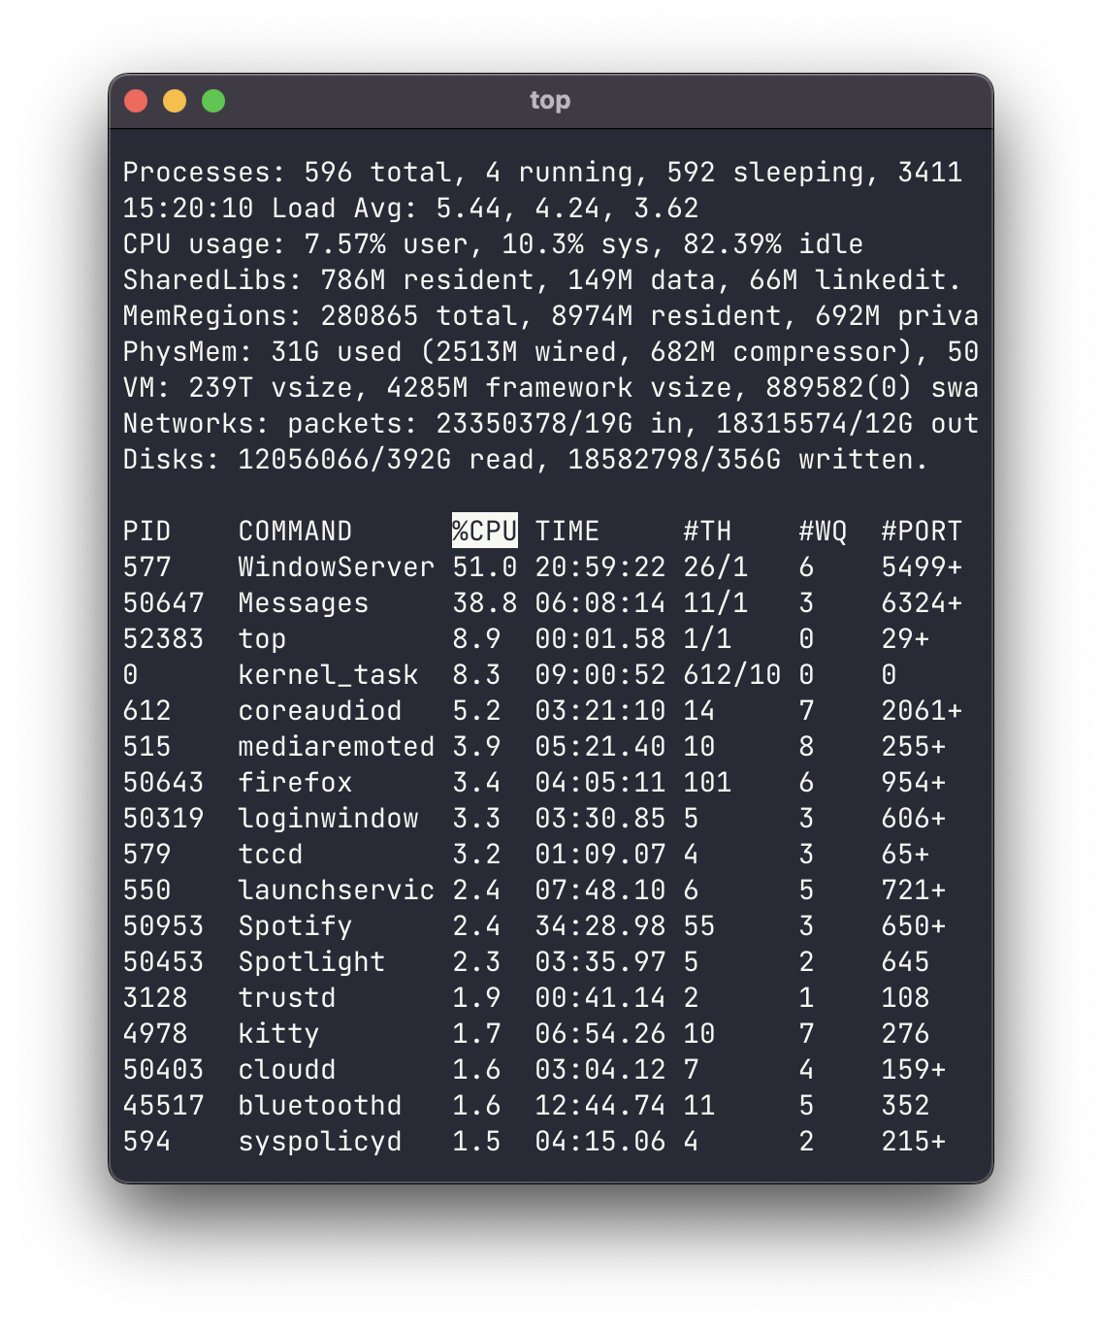
THIS… THIS IS BORING… WE DON’T LIKE IT

Slide 15
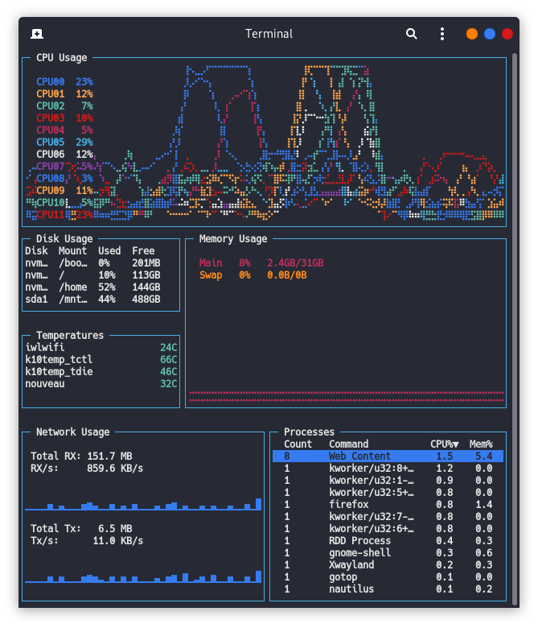
LET’S CHANGE THAT…
With fancy new terminal-based activity monitors! Because we look cool using them…

Slide 16
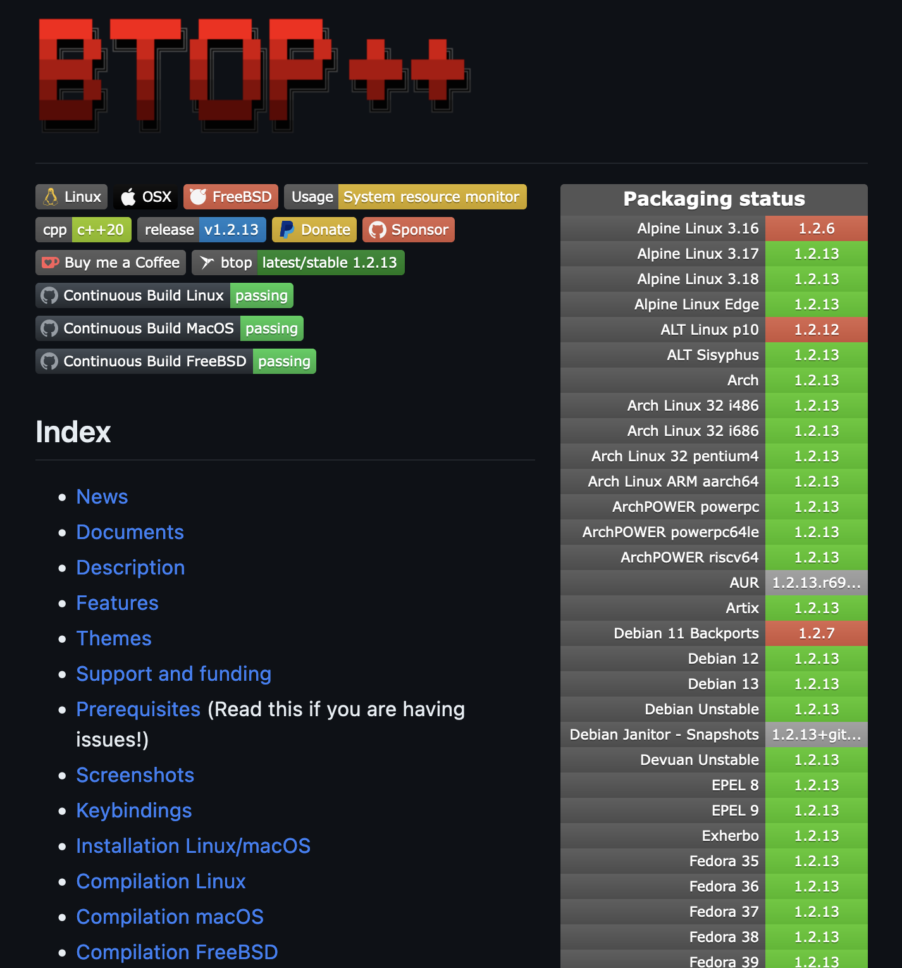
LUCKY FOR US… THERE’S PLENTY!
Here are some of our favorites! (By ours I definitely don’t mean mine)
HTOP
https://github.com/htop-dev/htop
BTOP
https://github.com/aristocratos/btop
GOTOP
https://github.com/cjbassi/gotop
You get the idea… Chances are if you search r/unixporn for TOP you’ll find something snazzy!

Slide 17
LET’S HAVE SOME FUN SHALL WE?

Slide 18
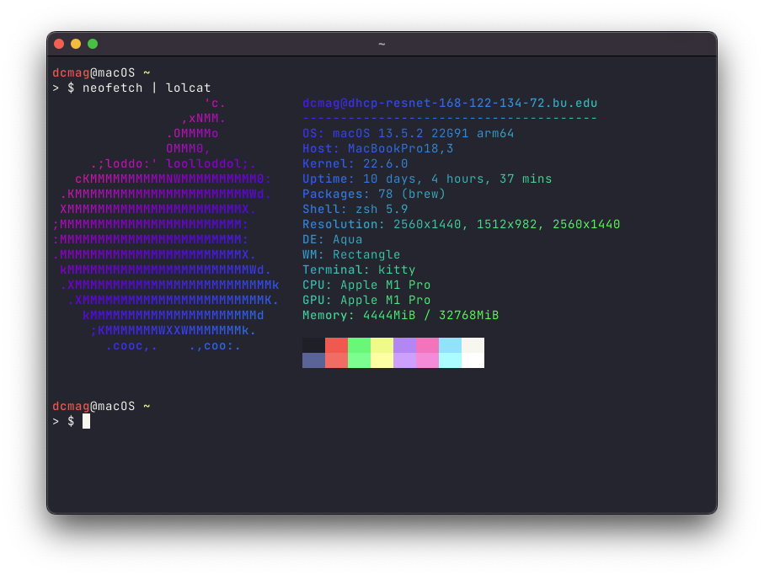
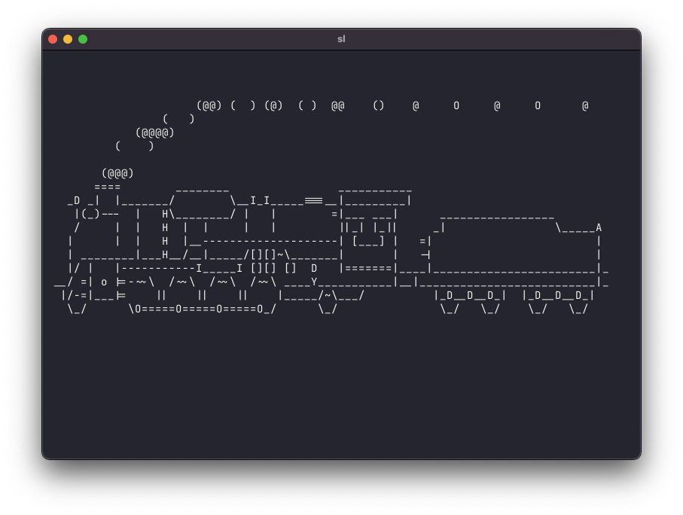
A FEW OF OUR FAVORITES!
Psst, here’s a bonus: (https://github.com/nvbn/thefuck)

Slide 19
SHELL CUSTOMIZATIONS

Slide 20
I’M GOING TO ASSUME MOST OF YOU ARE ON ZSHELL BUT…
THESE WORK SIMILAR FOR BASH TOO!

Slide 21
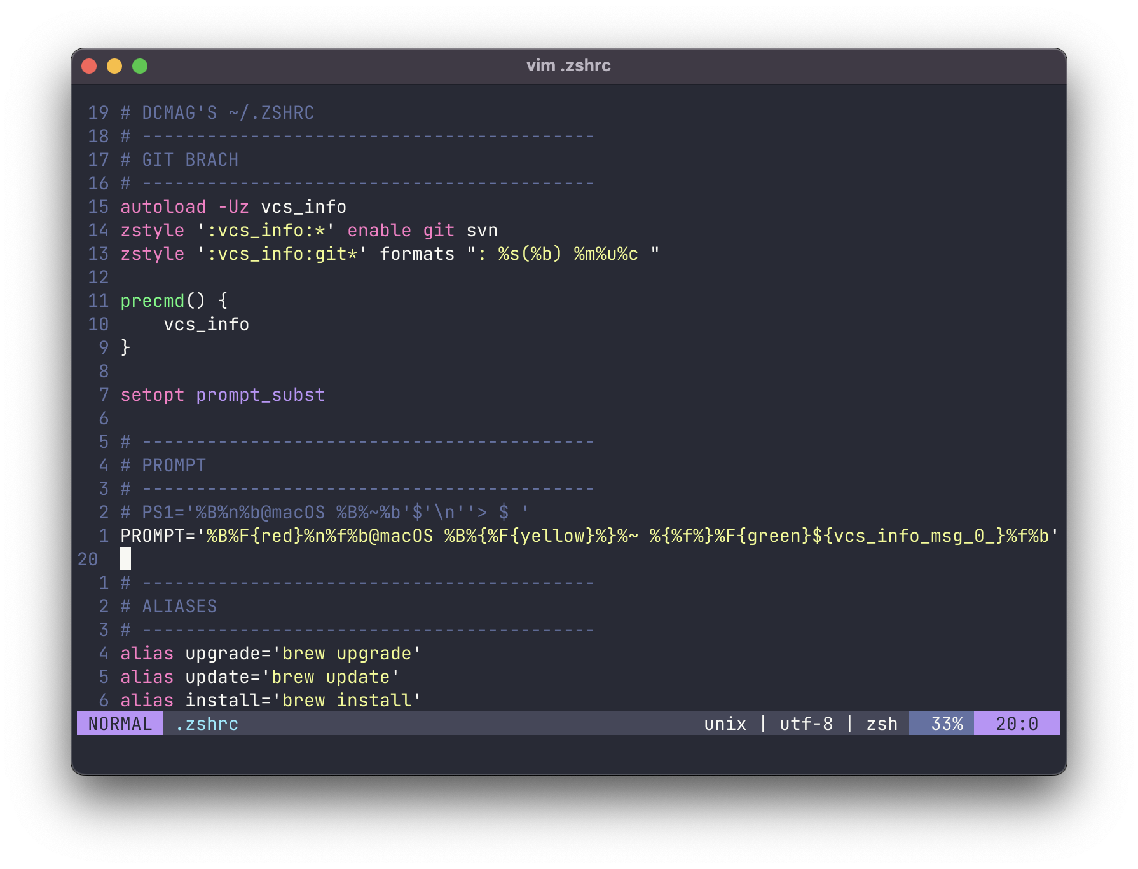
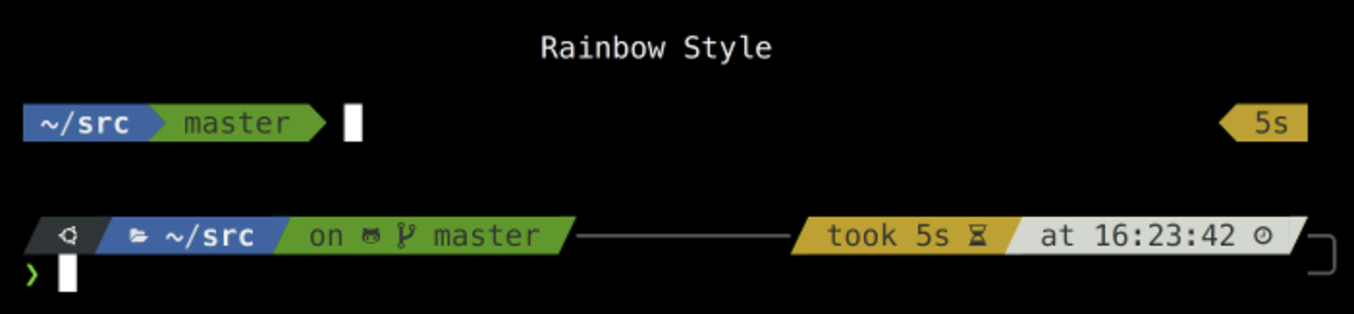
CUSTOM PROMPTS
This can get very complex… BUT
PS1=" \[\033[1;36m\]\w >\[\033[1;34m\]>\[\033[0m\] "
Here is a pretty cool one I found. Powerlevel10k is also an option :)

Slide 22
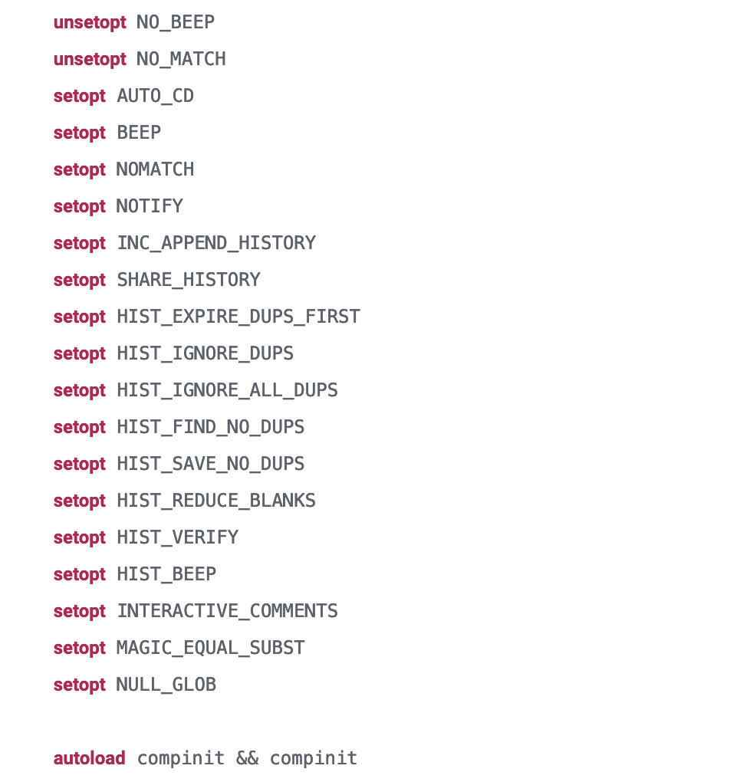
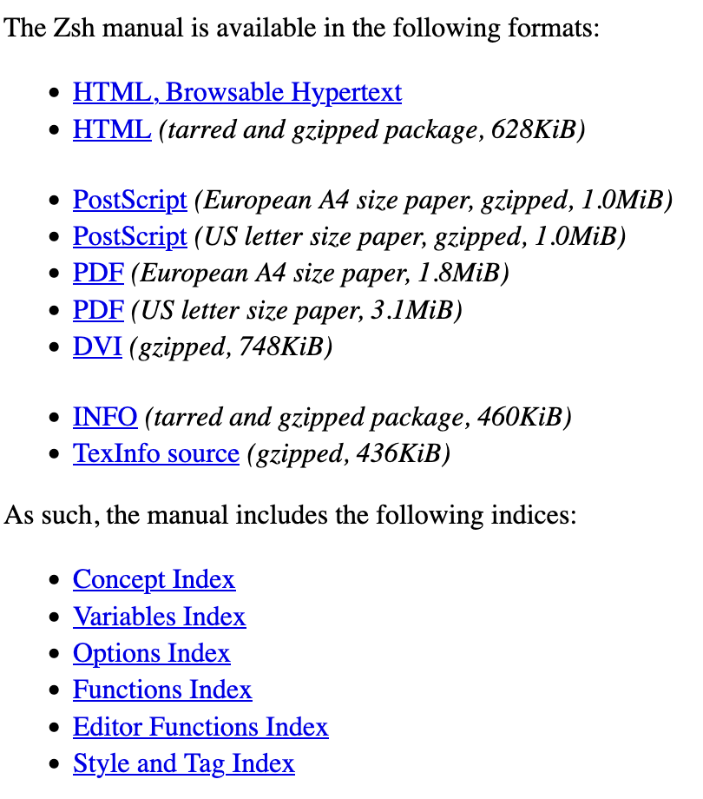
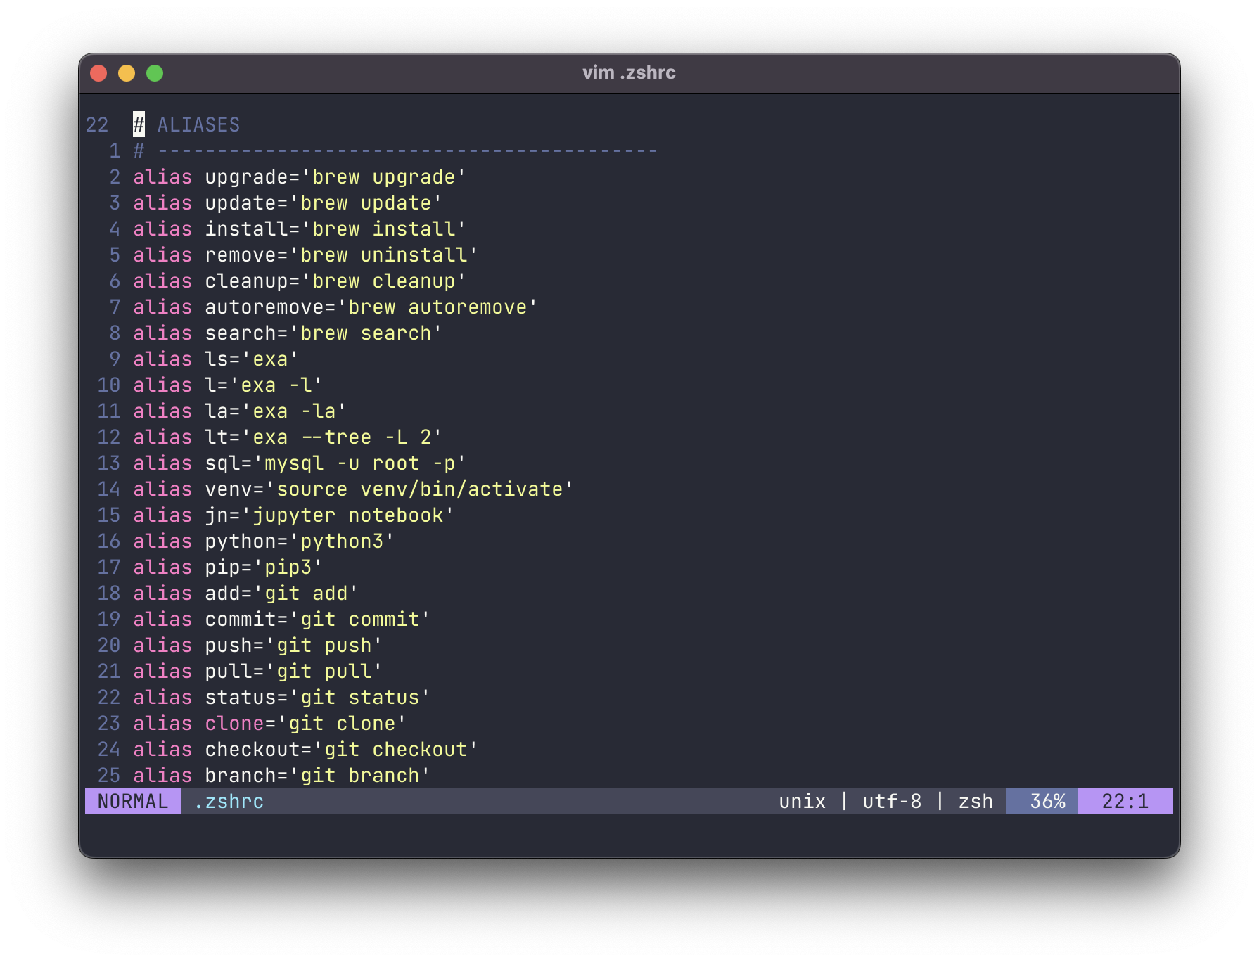
SETTINGS AND ALIASES
Settings are well.. Settings they customize how your shell acts!
Aliases are kind of like how typing “omw” on your iPhone auto expands to “On my way!”

Slide 23
“TOOLS” THAT DO IT ALL

Slide 24
AGAIN! I’M GOING OVER ZSHELL HERE

Slide 25
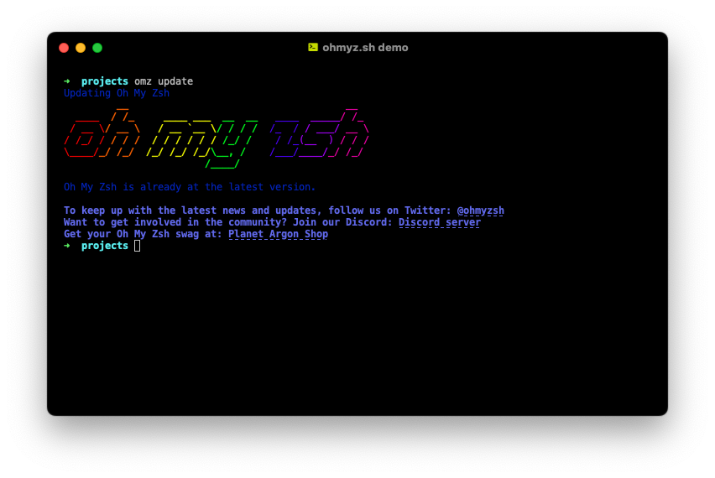
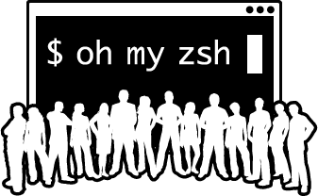
OH-MY-ZSH! WE KNOW IT, YOU’LL LOVE IT
Kind of like a cheat code for customizing your zsh on MacOS!
There’s way too much in Oh My Zsh to talk about in this presentation but plenty of articles, videos, blogs, etc. all about it!
https://ohmyz.sh/ ← Trust me, you’ll want to check this out!

Slide 26


